Slide 1
Systems, Roles, and Development Methodologies
1
Systems Analysis and Design, 8e
Kendall & Kendall

Slide 2
Learning Objectives
Recall the basic types of computer-based systems that a systems analyst needs to address.
Understand how users working in context with new technologies change the dynamics of a system.
Realize what the many roles of the systems analyst are.
Comprehend the fundamentals of three development methodologies: SDLC, the agile approach, and object-oriented systems analysis and design .
Understand what CASE tools are and how they help a systems analyst.
Kendall & Kendall Copyright © 2011 Pearson Education, Inc. Publishing as Prentice Hall
1-<number>

Slide 3
Information—A Key Resource
Fuels business and can be the critical factor in determining the success or failure of a business
Needs to be managed correctly
Managing computer-generated information differs from handling manually produced data
Kendall & Kendall Copyright © 2011 Pearson Education, Inc. Publishing as Prentice Hall
1-<number>
Notes:
Information is now considered a key resource and must be managed the same as any other key resource of an organization.
Decision makers now understand that information is not just a byproduct of doing business
Needs to be managed correctly. Costs are associated with the production, distribution, security, storage, and retrieval of all information. Its strategic use for positioning a business competitively should not be taken for granted.
With the availability of networked computers, along with access to the Internet and the WWW we are in the midst of an information explosion. The managing of computer-generated information rises issues with greater cost associated with organizing and maintaining and having users treat it less skeptically than information obtained in different ways.

Slide 4
Major Topics
Fundamentals of different kinds of information systems
Roles of systems analysts
Phases in the systems development life cycle as they relate to Human-Computer Interaction (HCI) factors
Computer-Aided Software Engineering (CASE) tools
Kendall & Kendall Copyright © 2011 Pearson Education, Inc. Publishing as Prentice Hall
1-<number>

Slide 5
Systems Analysts Recommend, Design, and Maintain Many Types of Systems for Users
  Transaction Processing Systems (TPS)
  Office Automation Systems (OAS)
  Knowledge Work Systems (KWS)
  Management Information Systems (MIS)
  Decision Support Systems (DSS)
  Expert Systems (ES)
  Executive Support Systems (ESS)
  Group Decision Support Systems (GDSS)
  Computer-Supported Collaborative Work Systems (CSCWS)
Kendall & Kendall Copyright © 2011 Pearson Education, Inc. Publishing as Prentice Hall
1-<number>
Notes:
Information systems are developed for different purposes, depending on the needs of the business.
Operational
TPS
Knowledge Level
OAS
KWS
Higher Level
MIS
DSS
ES
Strategic Level
ESS
GDSS
CSCWS

Slide 6
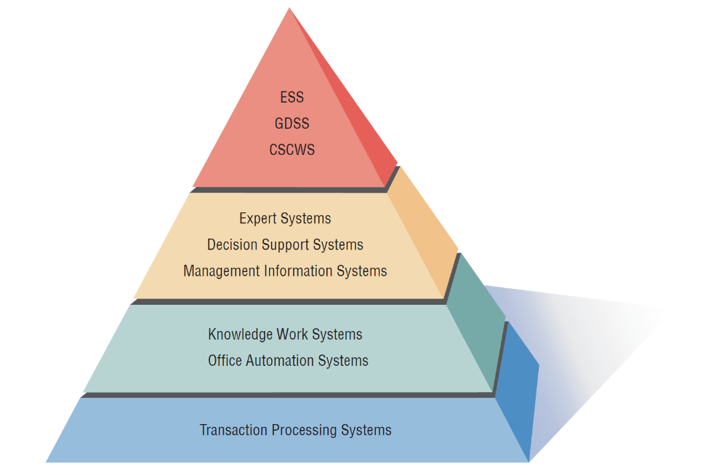
A systems analyst may be involved with any or all of these systems at each organization level.
Strategic Level
Higher Level
Knowledge Level
Operational Level
Kendall & Kendall Copyright © 2011 Pearson Education, Inc. Publishing as Prentice Hall
1-<number>
Notes:
As we move from the bottom to the top, each level represents a higher level of decision support. The bottom level or organizational level supported by TPS provides very structured decision support while the top level or strategic level supported by ESS, GDSS and CSCWS provides semi-structured and unstructured decision support.

Slide 7
Operational Level
Transaction Processing System (TPS)
  Process large amounts of data for routine business transactions
  Boundary-spanning
  Support the day-to-day operations of the company
  Examples: Payroll Processing, Inventory Management
Kendall & Kendall Copyright © 2011 Pearson Education, Inc. Publishing as Prentice Hall
1-<number>
Notes:
Eliminates the tedium of necessary operational transactions and reduces the time once required to perform them manually.
TPS are boundary-spanning systems that permit the organization to interact with external environments.
It is essential to the day-to-day operations of business that Transaction processing systems function smoothly and without interruption.

Slide 8
Knowledge Level
Office Automation System (OAS)
  Supports data workers who share information, but do not usually create new knowledge
  Examples: word processing, spreadsheets, desktop publishing, electronic scheduling, communication through voice mail, email, teleconferencing
Knowledge Work System (KWS)
  Supports professional workers such as scientists, engineers, and doctors
  Examples: computer-aided design systems, virtual reality systems, investment workstations
Kendall & Kendall Copyright © 2011 Pearson Education, Inc. Publishing as Prentice Hall
1-<number>
Notes:
OAS – support data workers, who do not usually create new knowledge but rather analyze information so as to transform data or manipulate it in some way before sharing it with, or formally disseminating it throughout, the organization and, sometimes beyond.
KWS – support professional workers such as scientists, engineers, and doctors by aiding them in their efforts to create new knowledge and by allowing them to contribute it to the organization or to society at large.
(CAD) Computer Aided Design - Automates creation, revision of products, and services
Virtual Reality - Interactive software creates simulations of real world activities
Investment workstations - Special work station to access and manipulate massive amounts of financial data

Slide 9
Higher Level
Management Information System (MIS)
  Supports a broad spectrum of organizational tasks including decision analysis and decision making
  Examples: profit margin by sales region, expenses vs. budgets
Decision Support System (DSS)
  Aids decision makers in the making of decisions
  Examples: financial planning with what-if analysis, budgeting with modeling
Expert System (ES) and Artificial Intelligence
  Captures and uses the knowledge of an expert for solving a particular problem which leads to a conclusion or recommendation
  Researching understanding natural language and the ability to reason through a problem to its logical conclusion
Kendall & Kendall Copyright © 2011 Pearson Education, Inc. Publishing as Prentice Hall
1-<number>
Notes:
MIS – Support management functions of organization. Transaction processing systems are a subset of management information systems. MIS includes a wider spectrum which includes decision analysis and decision making.
Management information systems use a database which contains both data and models that help the user interpret and apply the data. The product produced by Management information systems is that used in decision making.
DSS – Much like an MIS except that it emphasizes the support of decision making in all its phases, although the actual decision is still left up to the decision maker. Closely tailored to the person or group using them.
ES – Uses the approaches of AI reasoning to solve the problems put to them by business and other users. These systems select the best solution to a problem or a specific class of problems.
Expert systems consist of:
knowledge base
inference engine – connects the user with the system by processing requests
user interface

Slide 10
Strategic Level
Executive Support System (ESS)
  Helps executives to make unstructured strategic decisions in an informed way
  Examples: drill-down analysis, status access
  For example, when viewing your company's total worldwide sales for each month of this year, you might drill down to see October's sales by country, then again to see October's sales in Afghanistan by product and so on.
Group Decision Support System (GDSS)
  Permit group members to interact with electronic support.
  Examples: email, Lotus Notes
Computer-Supported Collaborative Work System (CSCWS)
  CSCWS is a more general term of GDSS.
  May include software support called groupware for team collaboration via network computers
  Example: video conferencing, Web survey system
Kendall & Kendall Copyright © 2011 Pearson Education, Inc. Publishing as Prentice Hall
1-<number>
Notes:
ESS – Help executives to make decisions at the strategic level by providing graphics and communication support technologies in accessible places. They help executives address unstructured decision problems by creating an environment which helps them think about strategic problems in an informed way.
GDSS – aids in group collaboration permitting group members to interact with electronic support such as polling, questionnaires, brainstorming, and scenario creation. Can be used to minimize negative group behaviors – lack of participation, domination by vocal group members, and “group think” decision making.
CSCWS – This is the more general term for group decision support systems.

Slide 11
Integrating New Technologies into Traditional Systems
Ecommerce and Web Systems
Enterprise Resource Planning Systems
Wireless and Mobile Systems
Open Source Software
Need for Systems Analysis and Design
Kendall & Kendall Copyright © 2011 Pearson Education, Inc. Publishing as Prentice Hall
1-<number>
Notes:
As new technologies are adopted they will need to be integrated with traditional systems. Systems analyst will be using these new technologies in helping people work to integrate ecommerce applications into traditional businesses or as they begin entirely new ebusinesses.

Slide 12
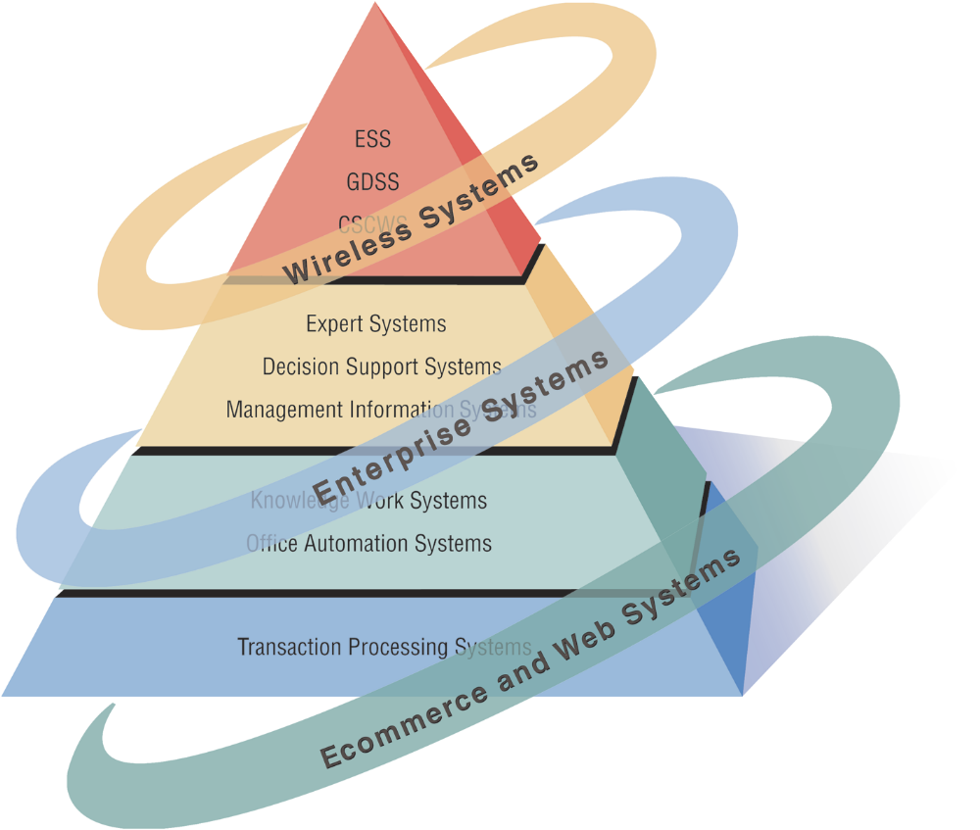
Systems Analysts Need to Be Aware that Integrating Technologies Affects all Types of Systems (Figure 1.2)
Kendall & Kendall Copyright © 2011 Pearson Education, Inc. Publishing as Prentice Hall
1-<number>

Slide 13
Ecommerce and Web Systems
Benefits
  Increasing user awareness of the availability of a service, product, industry, person, or group
  The possibility of 24-hour access for users
  Improving the usefulness and usability of interface design
  Creating a system that can extend globally rather than remain local, thus reaching people in remote locations without worry of the time zone in which they are located
Kendall & Kendall Copyright © 2011 Pearson Education, Inc. Publishing as Prentice Hall
1-<number>
Notes:
The systems covered can have much greater functionality if they are migrated to the World Wide Web or if they are originally conceived and implemented as Web-based technologies.

Slide 14
Enterprise Resource Planning Systems (ERP)
Performs integration of many information systems existing on different management levels and within different functions
Example: SAP, Oracle
Kendall & Kendall Copyright © 2011 Pearson Education, Inc. Publishing as Prentice Hall
1-<number>
Notes:
Instituting ERP requires enormous commitment and organizational change.
Generally systems analysts server as consultants to ERP endeavors that use proprietary software.
To properly design, install, maintain, update, and use a ERP package, analysts as well as some users require vendor training, support, and maintenance.

Slide 15
Wireless and Mobile Systems
A system analyst may be asked to design standard or wireless and mobile communication networks that integrate voice, video, and email into organizational intranets or industry extranets.
A system analyst may also be asked to develop intelligent agents.
Example: iPhone, iPod, BlackBerry
Wireless communication is referred to as m-commerce (mobile commerce).
Kendall & Kendall Copyright © 2011 Pearson Education, Inc. Publishing as Prentice Hall
1-<number>
Notes:
Analysts are being called to design a plethora of new systems and applications.
May be asked to develop under the standard called Bluetooth.
Intelligent agents are software that can assist users with tasks in which the software learns preferences from of users over time and then acts on those preferences.
Microsoft is developing software based on Bayesian statistics and decision making theory in combination with monitoring a user’s behavior concerning the handling of incoming information. Referred to as notification manager software that also places a dollar value on each piece of incoming information.

Slide 16
Open Source Software
An alternative of traditional software development where proprietary code is hidden from the users
Open source software is free to distribute, share, and modify.
Characterized as a philosophy rather than simply the process of creating new software
Example: Linux Operating System, Apache Web Server, Mozilla Firefox Web Browser
Kendall & Kendall Copyright © 2011 Pearson Education, Inc. Publishing as Prentice Hall
1-<number>
Notes:
A movement to create, distribute, share and modify software which is not proprietary.
It’s not a monolithic movement instead it has been categorized into four community types:
Ad hoc
Standardized
Organized
Commercial
The four communities in turn differ from each other on six key dimensions:
General structure
Environment
Goals
Methods
User community
Licensing

Slide 17
Need for Systems Analysis and Design
Installing a system without proper planning leads to great user dissatisfaction and frequently causes the system to fall into disuse.
Lends structure to the analysis and design of information systems
A series of processes systematically undertaken to improve a business through the use of computerized information systems
Kendall & Kendall Copyright © 2011 Pearson Education, Inc. Publishing as Prentice Hall
1-<number>
Notes:
User involvement throughout the systems project is critical to the successful development of computerized information systems.
New technologies are also driving the need for systems analysis. Ajax and Ruby on Rails are two examples.

Slide 18
Roles of the Systems Analyst
The analyst must be able to work with people of all descriptions and be experienced in working with computers.
Three primary roles:
  Consultant
  Supporting expert
  Agent of change
Kendall & Kendall Copyright © 2011 Pearson Education, Inc. Publishing as Prentice Hall
1-<number>
Notes:
The systems analyst systematically assesses how users interact with technology and business function by examining the inputting of information with the intend of improving organizational processes.
The analyst needs to play many roles, balancing several at the same time.
Consultant: Advantage – can bring with them a fresh perspective that other people in an organization do not possess.
Disadvantage – true organizational structure can never be known to an outsider.
Supporting expert:
Draws on professional expertise concerning computer hardware and software and their uses in the business.
Serves as a resource for those who are working on and managing other projects
Agent of change:
A person who serves as a catalyst for change, develops a plan for change, and works with others in facilitating that change.

Slide 19
Qualities of the Systems Analyst
Problem solver
Communicator
Strong personal and professional ethics
Self-disciplined and self-motivated
Kendall & Kendall Copyright © 2011 Pearson Education, Inc. Publishing as Prentice Hall
1-<number>
Notes:
The successful systems analyst must possess a wide range of qualities.
Problem solver – views the analysis of problems as a challenge and enjoys devising workable solutions.
Communicator – capable of relating meaningfully to other people over extended periods over time. Need enough computer experience to program, to understand the capabilities of computers, glean information requirements from users, and communicate what is needed to programmers.
Strong personal and professional ethics – they need to shape their client relationships
Self-disciplined and self-motivated – must be able to coordinate other people as well as innumerable project resources.

Slide 20
Systems Development Life Cycle (SDLC)
The systems development life cycle is a phased approach to solving business problems.
Developed through the use of a specific cycle of analyst and user activities
Each phase has unique user activities.
Kendall & Kendall Copyright © 2011 Pearson Education, Inc. Publishing as Prentice Hall
1-<number>
Notes:
Analysts disagree on exactly how many phases there are in the SDLC.
Each phase consists of activities which overlap into other phases and then taper off, rather then done in separate steps.

Slide 21
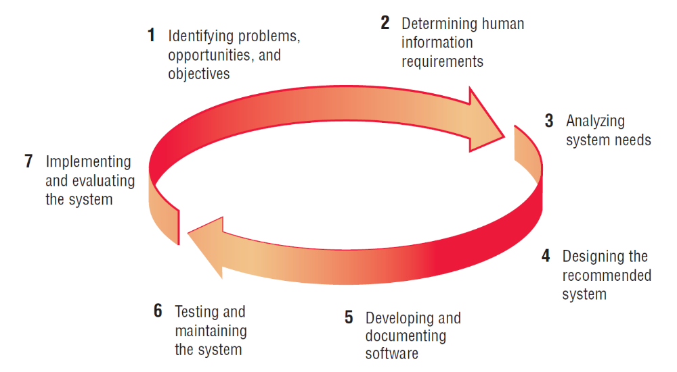
The Seven Phases of the Systems Development Life Cycle (Figure 1.3)
Kendall & Kendall Copyright © 2011 Pearson Education, Inc. Publishing as Prentice Hall
1-<number>

Slide 22
Incorporating Human-Computer Interaction (HCI) Considerations
The demand for analysts who are capable of incorporating HCI into the systems development process keeps increasing, as companies begin to realize that the quality of systems and the quality of work life can be improved by taking a human-centered approach at the outset of a project.
Kendall & Kendall Copyright © 2011 Pearson Education, Inc. Publishing as Prentice Hall
1-<number>
Notes:
HCI is that aspect of a computer that enables communications and interactions between human and computer. Implementing HCI into SDLC implies emphasizing people rather than the work to be done or the IT that is involved.
Adopting HCI principles examines a variety of user needs:
physical or ergonomic factors
usability factors
pleasing, aesthetic and enjoyable aspects
behavioral aspects
HCI can be thought of as a human-centered approach that puts people ahead of organizational structure

Slide 23
Identifying Problems, Opportunities, and Objectives
Activity:
  Interviewing user management
  Summarizing the knowledge obtained
  Estimating the scope of the project
  Documenting the results
Output:
  Feasibility report containing problem definition and objective summaries from which management can make a decision on whether to proceed with the proposed project
Kendall & Kendall Copyright © 2011 Pearson Education, Inc. Publishing as Prentice Hall
1-<number>
Notes:
Critical to the success of the rest of the project, because no one wants to waste time addressing the wrong problem.
Problems – generally the reason the analyst was called in in the first place.
Opportunities – situations that the analyst believes can be improved through the use of computerized information systems.
Objectives – how can the business reach its objectives by addressing specific problems or opportunities.

Slide 24
Determining Human Information Requirements
Activity:
  Interviewing
  Sampling and investing hard data
  Questionnaires
  Observe the decision maker’s behavior and environment.
  Prototyping
  Learn the who, what, where, when, how, and why of the current system.
Output:
  The analyst understands how users accomplish their work when interacting with a computer; and begin to know how to make the new system more useful and usable. The analyst should also know the business functions and have complete information on the people, goals, data, and procedure involved.
Kendall & Kendall Copyright © 2011 Pearson Education, Inc. Publishing as Prentice Hall
1-<number>
Notes:
Determining human needs of the users involved.
Uses activities to pose and answer questions concerning human-computer interaction:
What are the users strengths and limitations?
Trying to understand what information users need to perform their jobs.
Who – the people who are involved
What – the business activity
Where – the environment in which the work takes place
When – the timing
How – how the current procedures are performed
Why – why the system uses the current system

Slide 25
Analyzing System Needs
Activity:
  Create data flow, activity, or sequence diagrams.
  Complete the data dictionary.
  Analyze the structured decisions made.
  Prepare and present the system proposal.
Output:
  Recommendation on what, if anything, should be done
Kendall & Kendall Copyright © 2011 Pearson Education, Inc. Publishing as Prentice Hall
1-<number>
Notes:
Data Flow Diagrams – chart the input, processes, and output of the business’s functions in a structured graphical form.
Data dictionary – lists all the data items used in the system, as well as their specifications.
Structured decisions made – those for which the conditions, condition alternatives, actions, and action rules can be determined.
Structure decision methods:
structures English
decision tables
decision trees
System proposal – summarizes what has been found
about users
usability and usefulness of current system
provides cost/benefit analysis of alternatives
makes recommendations on what (if anything) should be done
The recommendation or solution is based on the analysts individual qualities and professional training and their interaction with users.

Slide 26
Designing the Recommended System
Activity:
  Design procedures for data entry.
  Design the human-computer interface.
  Design system controls.
  Design database and/or files.
  Design backup procedures.
Output
  Model of the actual system
Kendall & Kendall Copyright © 2011 Pearson Education, Inc. Publishing as Prentice Hall
1-<number>
Notes:
Uses the information collected earlier to accomplish the logical design of the information system:
designs procedures for users to help them accurately enter data
provides for users to complete effective input to the information system
devises the human-computer interface
designs files or databases that will store the data needed by decision makers
designs output (onscreen or printed)
designs controls and backup procedures

Slide 27
Developing and Documenting Software
Activity:
  System analyst works with programmers to develop any original software.
  Works with users to develop effective documentation.
  Programmers design, code, and remove syntactical errors from computer programs.
  Document software with help files, procedure manuals, and Web sites with Frequently Asked Questions.
Output:
  Computer programs
  System documentation
Kendall & Kendall Copyright © 2011 Pearson Education, Inc. Publishing as Prentice Hall
1-<number>
Notes:
The analyst uses structure charts and pseudocode to communicate to the programmer what needs to be programmed.
Documentation includes:
procedure manuals
online help
Web sites
“Read Me” files
Because users are involved from the beginning, the documentation should address the questions they have raised and solved jointly with the analyst.

Slide 28
Testing and Maintaining the System
Activity:
  Test the information system.
  System maintenance.
  Maintenance documentation.
Output:
  Problems, if any
  Updated programs
  Documentation
Kendall & Kendall Copyright © 2011 Pearson Education, Inc. Publishing as Prentice Hall
1-<number>
Notes:
Testing should take place first with sample data and then with actual data.
Testing is done by both the programmers and the analyst
The maintenance started here is carried out routinely through the life of the system.
updates may be performed via a vendor site on the Web.

Slide 29
Implementing and Evaluating the System
Activity:
  Train users.
  Analyst plans smooth conversion from old system to new system.
  Review and evaluate system.
Output:
  Trained personnel
  Installed system
Kendall & Kendall Copyright © 2011 Pearson Education, Inc. Publishing as Prentice Hall
1-<number>
Notes:
Training users to handle the system.
System conversion – converting files from old formats to new ones, or building a database, installing equipment, and bringing the new system into production.
Actually evaluation takes place during every phase.

Slide 30
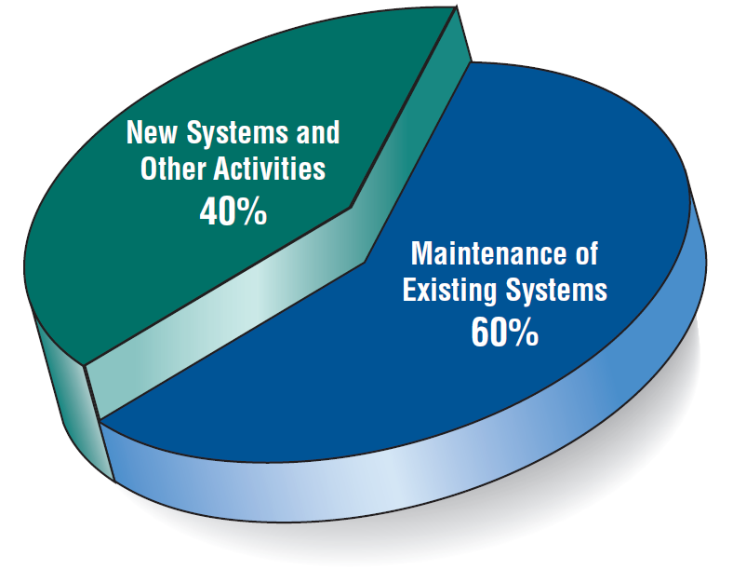
Some Researchers Estimate that the Amount of Time Spent on Systems Maintenance May Be as Much as 60 Percent of the Total Time Spent on Systems Projects (Figure 1.4)
Kendall & Kendall Copyright © 2011 Pearson Education, Inc. Publishing as Prentice Hall
1-<number>

Slide 31
The Impact of Maintenance
Maintenance is performed for two reasons:
  Removing software errors
  Enhancing existing software
Over time the cost of continued maintenance will be greater than that of creating an entirely new system. At that point it becomes more feasible to perform a new systems study.
Kendall & Kendall Copyright © 2011 Pearson Education, Inc. Publishing as Prentice Hall
1-<number>
Notes:
Computer programs must be modified and kept up to date.
Reasons for enhancing existing software –
users request additional features
business changes over time
hardware and software change

Slide 32
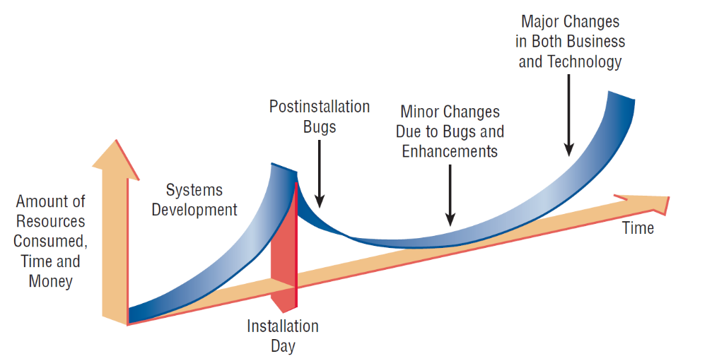
Resource Consumption over the System Life (Figure 1.5)
Kendall & Kendall Copyright © 2011 Pearson Education, Inc. Publishing as Prentice Hall
1-<number>
Notes:
Area under the curve represents the total dollar amount.
Eventually maintenance exceeds the cost of a creating a new system. At that point a new systems study should be untaken.

Slide 33
Approaches to Structured Analysis and Design and to the Systems Development Life Cycle
Traditional systems development life cycle
Computerised Aided Software Engineering (CASE) systems development life cycle
Object-oriented systems analysis and design
Kendall & Kendall Copyright © 2011 Pearson Education, Inc. Publishing as Prentice Hall
1-<number>

Slide 34
Case Tools
CASE tools are productivity tools for systems analysts that have been created explicitly to improve their routine work through the use of automated support.
Reasons for using CASE tools
  Increasing analyst productivity
  Improving analyst-user communication
  Integrating life cycle activities
Kendall & Kendall Copyright © 2011 Pearson Education, Inc. Publishing as Prentice Hall
1-<number>
Notes:
Increasing analyst productivity –
automates the drawing and modifying of diagrams
automates the sharing of work thus reducing the time to collaborate with group members
facilitates interaction among team members by making diagramming a dynamic, interactive process.
Improving Analyst-User Communication – CASE tools foster greater, more meaningful communication among users and analysts.
Integrating Life Cycle Activities – integration of activities through the underlying use of technologies makes it easier for users to understand how all the life cycle phases are interrelated and interdependent.
Accurately Assessing Maintenance Changes – enable users to analyze and assess the impact of maintenance changes.

Slide 35
Case Tool Classifications
Upper CASE tools perform analysis and design.
Lower CASE tools generate programs from CASE design.
Kendall & Kendall Copyright © 2011 Pearson Education, Inc. Publishing as Prentice Hall
1-<number>
Notes:
Upper CASE support analyst and designers
Lower CASE support programmers and workers who must implement the systems design via Upper CASE.

Slide 36
Upper CASE Tools
Create and modify the system design.
Help in modeling organizational requirements and defining system boundaries.
Kendall & Kendall Copyright © 2011 Pearson Education, Inc. Publishing as Prentice Hall
1-<number>
Notes:
All the information about the project is stored in the CASE repository. From the CASE repository analysis reports can be produced to show where the design is incomplete or contains errors.
The repository is a collection of records, elements, diagrams, screens, reports, and other information.
By modeling organizational requirements and defining system boundaries the analyst can visualize how the project meshes with other parts of the organization.

Slide 37
Lower CASE Tools
Lower CASE tools generate computer source code from the CASE design.
Source code is usually generated in several languages.
Decreases maintenance time
Generates error-free code
Kendall & Kendall Copyright © 2011 Pearson Education, Inc. Publishing as Prentice Hall
1-<number>
Notes:
CASE code generation has several advantages:
1. Quicker than writing computer programs.
2. Time spent on maintenance decreases.
3. Code can be generated in more than one computer language.
4. Cost-effective for tailoring systems purchased from third-party vendors.
5. Generated code is free from computer program errors.

Slide 38
The Agile Approach
Based on:
  Values
  Principles
  Core practices
Kendall & Kendall Copyright © 2011 Pearson Education, Inc. Publishing as Prentice Hall
1-<number>

Slide 39
Agile Values
Communication
Simplicity
Feedback
Courage
Kendall & Kendall Copyright © 2011 Pearson Education, Inc. Publishing as Prentice Hall
1-<number>

Slide 40
Four Agile Resources
Resources are adjusted to ensure successful project completion.
  Time
  Cost
  Quality
  Scope
Kendall & Kendall Copyright © 2011 Pearson Education, Inc. Publishing as Prentice Hall
1-<number>

Slide 41
Five Stages of Agile Development
Exploration
Planning
Iterations to the first release
Productionizing
Maintenance
Kendall & Kendall Copyright © 2011 Pearson Education, Inc. Publishing as Prentice Hall
1-<number>

Slide 42
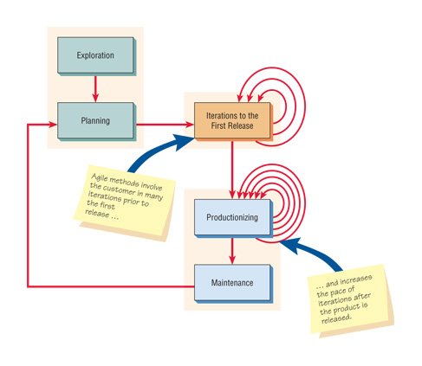
Agile Project Development Process (Figure 1.7)
Kendall & Kendall Copyright © 2011 Pearson Education, Inc. Publishing as Prentice Hall
1-<number>

Slide 43
Object-Oriented (O-O) Systems Analysis and Design
Alternate approach to the structured approach of the SDLC that is intended to facilitate the development of systems that change rapidly in response to dynamic business environments
Analysis is performed on a small part of the system followed by design and implementation.
The cycle repeats with analysis, design, and implementation of the next part and this repeats until the project is complete.
Examines the objects of a system
Kendall & Kendall Copyright © 2011 Pearson Education, Inc. Publishing as Prentice Hall
1-<number>
Notes:
Generally works well in situations where complicated information systems are undergoing continuous maintenance, adaptation, and redesign.

Slide 44
Choosing a Method
Choose either:
  SDLC
  Agile
  Object-oriented methodologies
Kendall & Kendall Copyright © 2011 Pearson Education, Inc. Publishing as Prentice Hall
1-<number>

Slide 45
When to Use SDLC
Systems have been developed and documented using SLDC.
It is important to document each step.
Upper level management feels more comfortable or safe using SDLC.
There are adequate resources and time to complete the full SDLC.
Communication of how new systems work is important.
Kendall & Kendall Copyright © 2011 Pearson Education, Inc. Publishing as Prentice Hall
1-<number>

Slide 46
When to Use Agile
There is a project champion of agile methods in the organization.
Applications need to be developed quickly in response to a dynamic environment.
A rescue takes place (the system failed and there is no time to figure out what went wrong).
The customer is satisfied with incremental improvements.
Executives and analysts agree with the principles of agile methodologies.
Kendall & Kendall Copyright © 2011 Pearson Education, Inc. Publishing as Prentice Hall
1-<number>

Slide 47
When to Use Object-Oriented
The problems modeled lend themselves to classes.
An organization supports the UML learning.
Systems can be added gradually, one subsystem at a time.
Reuse of previously written software is a possibility.
It is acceptable to tackle the difficult problems first.
Kendall & Kendall Copyright © 2011 Pearson Education, Inc. Publishing as Prentice Hall
1-<number>

Slide 48
Summary
Information is a key resource.
Systems analysts deal with many types of information systems.
Integration of traditional systems with new technologies
Roles and qualities of the systems analyst
The systems development life cycle
CASE tools
Agile systems development
Object-oriented systems development
Kendall & Kendall Copyright © 2011 Pearson Education, Inc. Publishing as Prentice Hall
1-<number>

